Slide 1
Unsupervised Machine Learning

Slide 2
What is Unsupervised Learning?
There may be many cases in which we do not have labeled data and need to find the hidden patterns from the given dataset. So, to solve such types of cases in machine learning, we need unsupervised learning techniques.
As the name suggests, unsupervised learning is a machine learning technique in which models are not supervised using training dataset. Instead, models itself find the hidden patterns and insights from the given data. It can be compared to learning which takes place in the human brain while learning new things.
Unsupervised learning cannot be directly applied to a regression or classification problem because unlike supervised learning, we have the input data but no corresponding output data. The goal of unsupervised learning is to find the underlying structure of dataset, group that data according to similarities, and represent that dataset in a compressed format.

Slide 3
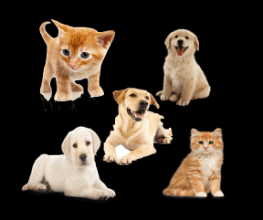
Example: Suppose the unsupervised learning algorithm is given an input dataset containing images of different types of cats and dogs. The algorithm is never trained upon the given dataset, which means it does not have any idea about the features of the dataset. The task of the unsupervised learning algorithm is to identify the image features on their own. Unsupervised learning algorithm will perform this task by clustering the image dataset into the groups according to similarities between images.

Slide 4
Why use Unsupervised Learning?
Below are some main reasons which describe the importance of Unsupervised Learning:
Unsupervised learning is helpful for finding useful insights from the data.
Unsupervised learning is much similar as a human learns to think by their own experiences, which makes it closer to the real AI.
Unsupervised learning works on unlabeled and uncategorized data which make unsupervised learning more important.
In real-world, we do not always have input data with the corresponding output so to solve such cases, we need unsupervised learning

Slide 5
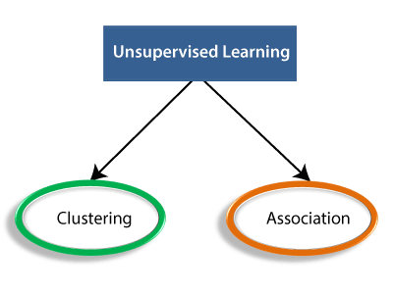
Working of Unsupervised Learning :
Working of unsupervised learning can be understood by the below diagram:
Clustering: Clustering is a method of grouping the objects into clusters such that objects with most similarities remains into a group and has less or no similarities with the objects of another group. Cluster analysis finds the commonalities between the data objects and categorizes them as per the presence and absence of those commonalities.
Association: An association rule is an unsupervised learning method which is used for finding the relationships between variables in the large database. It determines the set of items that occurs together in the dataset. Association rule makes marketing strategy more effective. Such as people who buy X item (suppose a bread) are also tend to purchase Y (Butter/Jam) item. A typical example of Association rule is Market Basket Analysis.

Slide 6
Unsupervised Learning algorithms:
Below is the list of some popular unsupervised learning algorithms:
K-means clustering
KNN (k-nearest neighbors)
Hierarchal clustering
Anomaly detection
Neural Networks
Principle Component Analysis
Independent Component Analysis
Apriori algorithm
Singular value decomposition

Slide 7
Advantages of Unsupervised Learning
Unsupervised learning is used for more complex tasks as compared to supervised learning because, in unsupervised learning, we don't have labeled input data.
Unsupervised learning is preferable as it is easy to get unlabeled data in comparison to labeled data.
Disadvantages of Unsupervised Learning
Unsupervised learning is intrinsically more difficult than supervised learning as it does not have corresponding output.
The result of the unsupervised learning algorithm might be less accurate as input data is not labeled, and algorithms do not know the exact output in advance

Slide 8
Clustering in Machine Learning :
Clustering or cluster analysis is a machine learning technique, which groups the unlabelled dataset.
"A way of grouping the data points into different clusters, consisting of similar data points. The objects with the possible similarities remain in a group that has less or no similarities with another group."
It does it by finding some similar patterns in the unlabelled dataset such as shape, size, color, behavior, etc., and divides them as per the presence and absence of those similar patterns.
It is an unsupervised learning method, hence no supervision is provided to the algorithm, and it deals with the unlabeled dataset.
After applying this clustering technique, each cluster or group is provided with a cluster-ID. ML system can use this id to simplify the processing of large and complex datasets.
The clustering technique is commonly used for statistical data analysis.

Slide 9
Example: Let's understand the clustering technique with the real-world example of Mall: When we visit any shopping mall, we can observe that the things with similar usage are grouped together. Such as the t-shirts are grouped in one section, and trousers are at other sections, similarly, at vegetable sections, apples, bananas, Mangoes, etc., are grouped in separate sections, so that we can easily find out the things. The clustering technique also works in the same way. Other examples of clustering are grouping documents according to the topic.
The clustering technique can be widely used in various tasks. Some most common uses of this technique are:
Market Segmentation
Statistical data analysis
Social network analysis
Image segmentation
Anomaly detection, etc.
Apart from these general usages, it is used by the Amazon in its recommendation system to provide the recommendations as per the past search of products. Netflix also uses this technique to recommend the movies and web-series to its users as per the watch history.

Slide 10
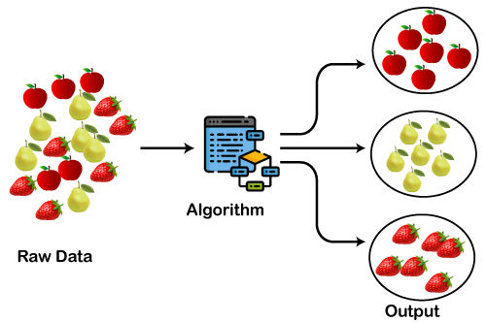
The below diagram explains the working of the clustering algorithm. We can see the different fruits are divided into several groups with similar properties.

Slide 11
Types of Clustering Methods
The clustering methods are broadly divided into Hard clustering (datapoint belongs to only one group) and Soft Clustering (data points can belong to another group also). But there are also other various approaches of Clustering exist. Below are the main clustering methods used in Machine learning:
Partitioning Clustering
Density-Based Clustering
Distribution Model-Based Clustering
Hierarchical Clustering
Fuzzy Clustering

Slide 12
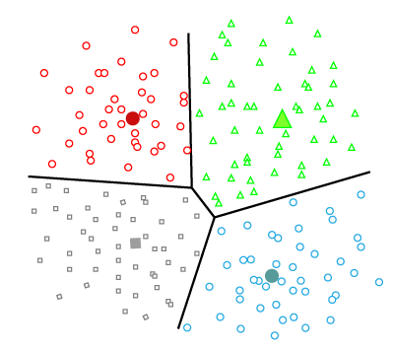
Partitioning Clustering :
It is a type of clustering that divides the data into non-hierarchical groups. It is also known as the centroid-based method. The most common example of partitioning clustering is the K-Means Clustering algorithm.
In this type, the dataset is divided into a set of k groups, where K is used to define the number of pre-defined groups. The cluster center is created in such a way that the distance between the data points of one cluster is minimum as compared to another cluster centroid.

Slide 13
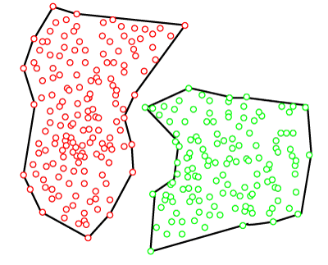
Density-Based Clustering :
The density-based clustering method connects the highly-dense areas into clusters, and the arbitrarily shaped distributions are formed as long as the dense region can be connected. This algorithm does it by identifying different clusters in the dataset and connects the areas of high densities into clusters. The dense areas in data space are divided from each other by sparser areas.
These algorithms can face difficulty in clustering the data points if the dataset has varying densities and high dimensions.

Slide 14
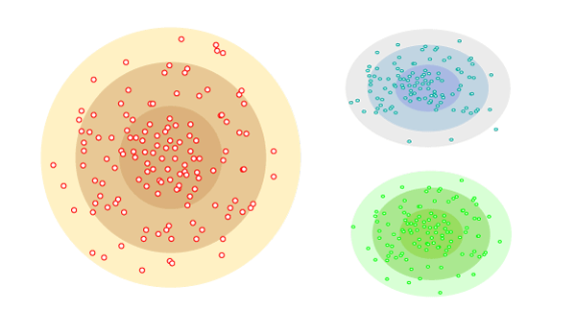
Distribution Model-Based Clustering :
In the distribution model-based clustering method, the data is divided based on the probability of how a dataset belongs to a particular distribution. The grouping is done by assuming some distributions commonly Gaussian Distribution.
The example of this type is the Expectation-Maximization Clustering algorithm that uses Gaussian Mixture Models (GMM).

Slide 15
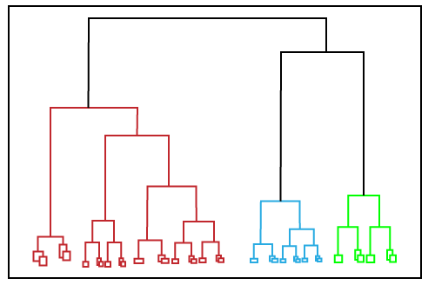
Hierarchical Clustering :
Hierarchical clustering can be used as an alternative for the partitioned clustering as there is no requirement of pre-specifying the number of clusters to be created. In this technique, the dataset is divided into clusters to create a tree-like structure, which is also called a dendrogram. The observations or any number of clusters can be selected by cutting the tree at the correct level. The most common example of this method is the Agglomerative Hierarchical algorithm.

Slide 16
Fuzzy Clustering :
Fuzzy clustering is a type of soft method in which a data object may belong to more than one group or cluster.
Each dataset has a set of membership coefficients, which depend on the degree of membership to be in a cluster.
Fuzzy C-means algorithm is the example of this type of clustering;
It is sometimes also known as the Fuzzy k-means algorithm.

Slide 17
Clustering Algorithms :
The Clustering algorithms can be divided based on their models that are explained above. There are different types of clustering algorithms published, but only a few are commonly used. The clustering algorithm is based on the kind of data that we are using. Such as, some algorithms need to guess the number of clusters in the given dataset, whereas some are required to find the minimum distance between the observation of the dataset.
Here we are discussing mainly popular Clustering algorithms that are widely used in machine learning:
K-Means algorithm: The k-means algorithm is one of the most popular clustering algorithms. It classifies the dataset by dividing the samples into different clusters of equal variances. The number of clusters must be specified in this algorithm. It is fast with fewer computations required, with the linear complexity of O(n).
Mean-shift algorithm: Mean-shift algorithm tries to find the dense areas in the smooth density of data points. It is an example of a centroid-based model, that works on updating the candidates for centroid to be the center of the points within a given region.
DBSCAN Algorithm: It stands for Density-Based Spatial Clustering of Applications with Noise. It is an example of a density-based model similar to the mean-shift, but with some remarkable advantages. In this algorithm, the areas of high density are separated by the areas of low density. Because of this, the clusters can be found in any arbitrary shape.

Slide 18
Expectation-Maximization Clustering using GMM: This algorithm can be used as an alternative for the k-means algorithm or for those cases where K-means can be failed. In GMM, it is assumed that the data points are Gaussian distributed.
Agglomerative Hierarchical algorithm: The Agglomerative hierarchical algorithm performs the bottom-up hierarchical clustering. In this, each data point is treated as a single cluster at the outset and then successively merged. The cluster hierarchy can be represented as a tree-structure.
Affinity Propagation: It is different from other clustering algorithms as it does not require to specify the number of clusters. In this, each data point sends a message between the pair of data points until convergence. It has O(N²T) time complexity, which is the main drawback of this algorithm.

Slide 19
Applications of Clustering:
Below are some commonly known applications of clustering technique in Machine Learning:
In Identification of Cancer Cells: The clustering algorithms are widely used for the identification of cancerous cells. It divides the cancerous and non-cancerous data sets into different groups.
In Search Engines: Search engines also work on the clustering technique. The search result appears based on the closest object to the search query. It does it by grouping similar data objects in one group that is far from the other dissimilar objects. The accurate result of a query depends on the quality of the clustering algorithm used.
Customer Segmentation: It is used in market research to segment the customers based on their choice and preferences.
In Biology: It is used in the biology stream to classify different species of plants and animals using the image recognition technique.
In Land Use: The clustering technique is used in identifying the area of similar lands use in the GIS database. This can be very useful to find that for what purpose the particular land should be used, that means for which purpose it is more suitable.

Slide 20
Hierarchical Clustering in Machine Learning

Slide 21
Hierarchical Clustering in Machine Learning:
Hierarchical clustering is another unsupervised machine learning algorithm, which is used to group the unlabeled datasets into a cluster and also known as hierarchical cluster analysis or HCA.
In this algorithm, we develop the hierarchy of clusters in the form of a tree, and this tree-shaped structure is known as the dendrogram.
Sometimes the results of K-means clustering and hierarchical clustering may look similar, but they both differ depending on how they work. As there is no requirement to predetermine the number of clusters as we did in the K-Means algorithm
The hierarchical clustering technique has two approaches:
Agglomerative: Agglomerative is a bottom-up approach, in which the algorithm starts with taking all data points as single clusters and merging them until one cluster is left.
Divisive: Divisive algorithm is the reverse of the agglomerative algorithm as it is a top-down approach.

Slide 22
Why hierarchical clustering?
As we already have other clustering algorithm such as K-Means Clustering, then why we need hierarchical clustering? So, as we have seen in the K-means clustering that there are some challenges with this algorithm, which are a predetermined number of clusters, and it always tries to create the clusters of the same size. To solve these two challenges, we can opt for the hierarchical clustering algorithm because, in this algorithm, we don't need to have knowledge about the predefined number of clusters.
Agglomerative Hierarchical clustering
The agglomerative hierarchical clustering algorithm is a popular example of HCA. To group the datasets into clusters, it follows the bottom-up approach. It means, this algorithm considers each dataset as a single cluster at the beginning, and then start combining the closest pair of clusters together. It does this until all the clusters are merged into a single cluster that contains all the datasets.
This hierarchy of clusters is represented in the form of the dendrogram.

Slide 23
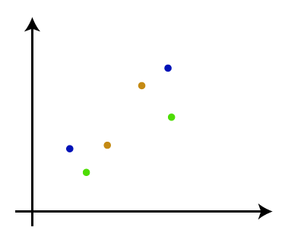
How the Agglomerative Hierarchical clustering Work?
The working of the AHC algorithm can be explained using the below steps:
Step-1: Create each data point as a single cluster. Let's say there are N data points, so the number of clusters will also be N.

Slide 24
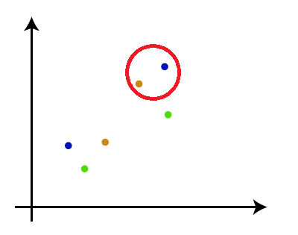
Step-2: Take two closest data points or clusters and merge them to form one cluster. So, there will now be N-1 clusters.

Slide 25
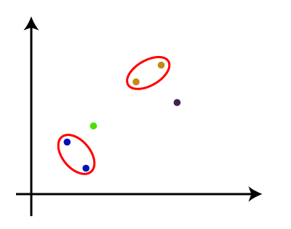
Step-3: Again, take the two closest clusters and merge them together to form one cluster.
There will be N-2 clusters.

Slide 26
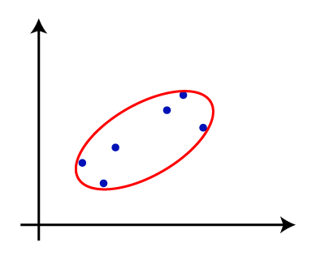
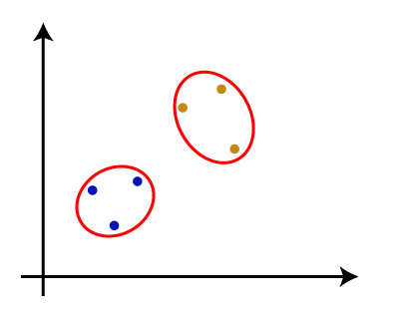
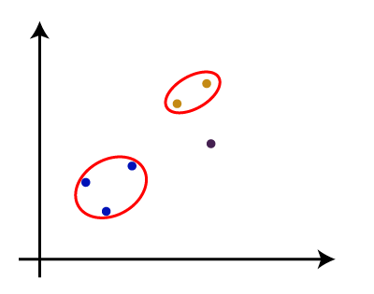
Step-4: Repeat Step 3 until only one cluster left. So, we will get the following clusters. Consider the below images:
Step-5: Once all the clusters are combined into one big cluster, develop the dendrogram to divide the clusters as per the problem.
Note: To better understand hierarchical clustering, it is advised to have a look on k-means clustering

Slide 27
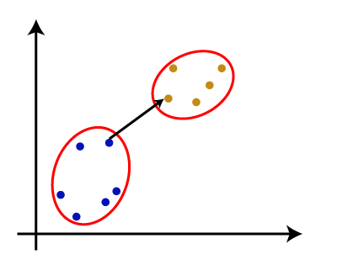
Measure for the distance between two clusters :
As we have seen, the closest distance between the two clusters is crucial for the hierarchical clustering. There are various ways to calculate the distance between two clusters, and these ways decide the rule for clustering. These measures are called Linkage methods.
Single Linkage: It is the Shortest Distance between the closest points of the clusters.

Slide 28
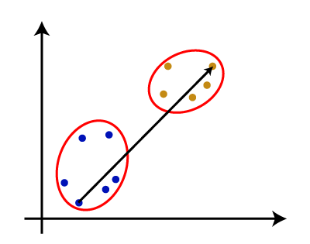
Complete Linkage: It is the farthest distance between the two points of two different clusters.
It is one of the popular linkage methods as it forms tighter clusters than single-linkage.

Slide 29
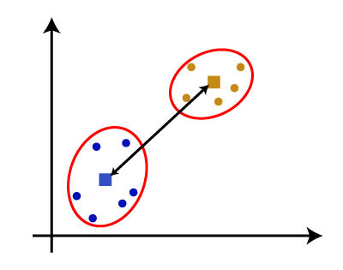
Average Linkage: It is the linkage method in which the distance between each pair of datasets is added up and then divided by the total number of datasets to calculate the average distance between two clusters. It is also one of the most popular linkage methods.
Centroid Linkage: It is the linkage method in which the distance between the centroid of the clusters is calculated. Consider the below image:
From the above-given approaches, we can apply any of them according to the type of problem or business requirement.

Slide 30
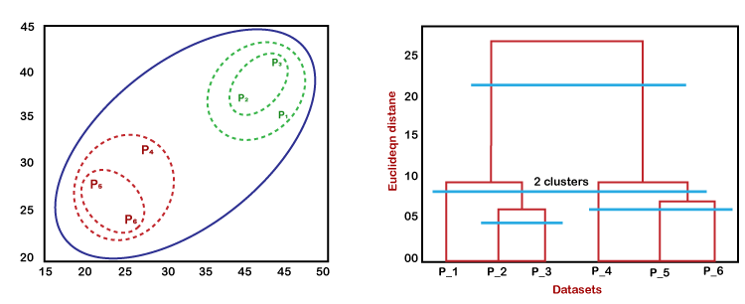
Working of Dendrogram in Hierarchical clustering :
The dendrogram is a tree-like structure that is mainly used to store each step as a memory that the HC algorithm performs. In the dendrogram plot, the Y-axis shows the Euclidean distances between the data points, and the x-axis shows all the data points of the given dataset.
In the above diagram, the left part is showing how clusters are created in agglomerative clustering, and the right part is showing the corresponding dendrogram.

Slide 31
As we have discussed above, firstly, the datapoints P2 and P3 combine together and form a cluster, correspondingly a dendrogram is created, which connects P2 and P3 with a rectangular shape. The hight is decided according to the Euclidean distance between the data points.
In the next step, P5 and P6 form a cluster, and the corresponding dendrogram is created. It is higher than of previous, as the Euclidean distance between P5 and P6 is a little bit greater than the P2 and P3.
Again, two new dendrograms are created that combine P1, P2, and P3 in one dendrogram, and P4, P5, and P6, in another dendrogram.
At last, the final dendrogram is created that combines all the data points together.
We can cut the dendrogram tree structure at any level as per our requirement.

Slide 32
Python Implementation of Agglomerative Hierarchical Clustering :
Now we will see the practical implementation of the agglomerative hierarchical clustering algorithm using Python.
To implement this, we will use the same dataset problem that we have used in the previous topic of K-means clustering so that we can compare both concepts easily.
The dataset is containing the information of customers that have visited a mall for shopping. So, the mall owner wants to find some patterns or some particular behavior of his customers using the dataset information.
Steps for implementation of AHC using Python:
The steps for implementation will be the same as the k-means clustering, except for some changes such as the method to find the number of clusters. Below are the steps:
Data Pre-processing
Finding the optimal number of clusters using the Dendrogram
Training the hierarchical clustering model
Visualizing the clusters

Slide 33
Data Pre-processing Steps:
In this step, we will import the libraries and datasets for our model.
Importing the libraries
# Importing the libraries
import numpy as nm
import matplotlib.pyplot as mtp
import pandas as pd
The above lines of code are used to import the libraries to perform specific tasks, such as numpy for the Mathematical operations, matplotlib for drawing the graphs or scatter plot, and pandas for importing the dataset.

Slide 34
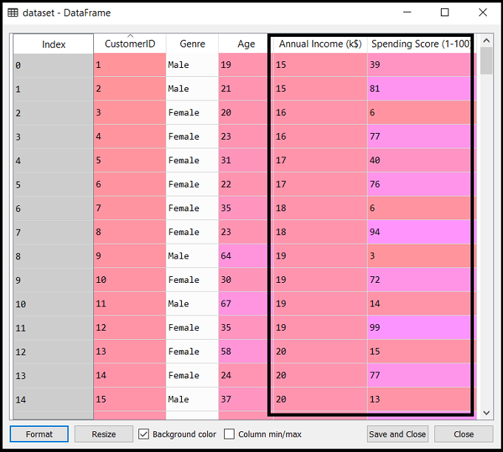
Importing the dataset:
# Importing the dataset
dataset = pd.read_csv('Mall_Customers_data.csv’)
As discussed above, we have imported the same dataset of Mall_Customers_data.csv, as we did in k-means clustering.

Slide 35
Extracting the matrix of features:
Here we will extract only the matrix of features as we don't have any further information about the dependent variable. Code is given below:
x = dataset.iloc[:, [3, 4]].values
Here we have extracted only 3 and 4 columns as we will use a 2D plot to see the clusters. So, we are considering the Annual income and spending score as the matrix of features.

Slide 36
Step-2: Finding the optimal number of clusters using the Dendrogram :
Now we will find the optimal number of clusters using the Dendrogram for our model. For this, we are going to use scipy library as it provides a function that will directly return the dendrogram for our code. Consider the below lines of code:
#Finding the optimal number of clusters using the dendrogram
import scipy.cluster.hierarchy as shc
dendro = shc.dendrogram(shc.linkage(x, method="ward"))
mtp.title("Dendrogrma Plot")
mtp.ylabel("Euclidean Distances")
mtp.xlabel("Customers")
mtp.show()
In the above lines of code, we have imported the hierarchy module of scipy library. This module provides us a method shc.denrogram(), which takes the linkage() as a parameter. The linkage function is used to define the distance between two clusters, so here we have passed the x(matrix of features), and method "ward," the popular method of linkage in hierarchical clustering.
The remaining lines of code are to describe the labels for the dendrogram plot.

Slide 37
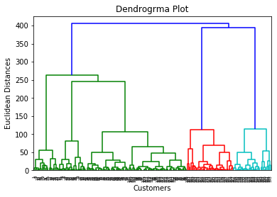
Output:
By executing the above lines of code, we will get the below output:
Using this Dendrogram, we will now determine the optimal number of clusters for our model. For this, we will find the maximum vertical distance that does not cut any horizontal bar. Consider the below diagram:

Slide 38
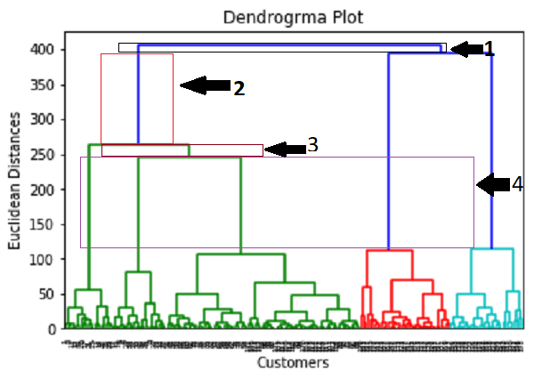
In the above diagram, we have shown the vertical distances that are not cutting their horizontal bars. As we can visualize, the 4th distance is looking the maximum, so according to this, the number of clusters will be 5(the vertical lines in this range). We can also take the 2nd number as it approximately equals the 4th distance, but we will consider the 5 clusters because the same we calculated in the K-means algorithm.

Slide 39
Step-3: Training the hierarchical clustering model :
As we know the required optimal number of clusters, we can now train our model. The code is given below:
#training the hierarchical model on dataset
from sklearn.cluster import AgglomerativeClustering
hc= AgglomerativeClustering(n_clusters=5, affinity='euclidean', linkage='ward')
y_pred= hc.fit_predict(x)
In the above code, we have imported the AgglomerativeClustering class of cluster module of scikit learn library.
Then we have created the object of this class named as hc. The AgglomerativeClustering class takes the following parameters:
n_clusters=5: It defines the number of clusters, and we have taken here 5 because it is the optimal number of clusters.
affinity='euclidean': It is a metric used to compute the linkage.
linkage='ward': It defines the linkage criteria, here we have used the "ward" linkage. This method is the popular linkage method that we have already used for creating the Dendrogram. It reduces the variance in each cluster.
In the last line, we have created the dependent variable y_pred to fit or train the model. It does train not only the model but also returns the clusters to which each data point belongs.

Slide 40
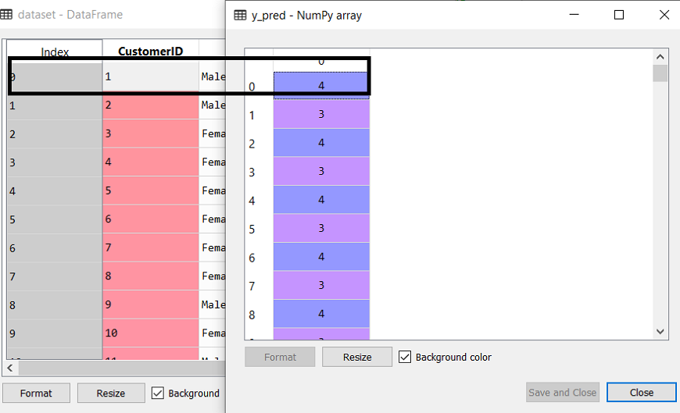
After executing the above lines of code, we can check the y_pred variable.
We can compare the original dataset with the y_pred variable.
Consider the below image:
As we can see in the above image, the y_pred shows the clusters value, which means the customer id 1 belongs to the 5th cluster (as indexing starts from 0, so 4 means 5th cluster), the customer id 2 belongs to 4th cluster, and so on.

Slide 41
Step-4: Visualizing the clusters :
As we have trained our model successfully, now we can visualize the clusters corresponding to the dataset.
Here we will use the same lines of code as we did in k-means clustering, except one change. Here we will not plot the centroid that we did in k-means, because here we have used dendrogram to determine the optimal number of clusters. The code is given below:
#visualizing the clusters
mtp.scatter(x[y_pred == 0, 0], x[y_pred == 0, 1], s = 100, c = 'blue', label = 'Cluster 1')
mtp.scatter(x[y_pred == 1, 0], x[y_pred == 1, 1], s = 100, c = 'green', label = 'Cluster 2')
mtp.scatter(x[y_pred== 2, 0], x[y_pred == 2, 1], s = 100, c = 'red', label = 'Cluster 3')
mtp.scatter(x[y_pred == 3, 0], x[y_pred == 3, 1], s = 100, c = 'cyan', label = 'Cluster 4')
mtp.scatter(x[y_pred == 4, 0], x[y_pred == 4, 1], s = 100, c = 'magenta', label = 'Cluster 5’)
mtp.title('Clusters of customers')
mtp.xlabel('Annual Income (k$)')
mtp.ylabel('Spending Score (1-100)')
mtp.legend()
mtp.show()

Slide 42
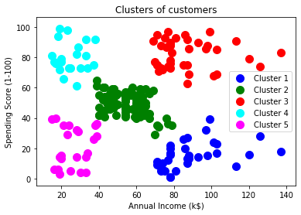
Output :

Slide 43
K-Means Clustering Algorithm :
K-Means Clustering is an unsupervised learning algorithm that is used to solve the clustering problems in machine learning or data science. In this topic, we will learn what is K-means clustering algorithm, how the algorithm works, along with the Python implementation of k-means clustering.
What is K-Means Algorithm?
K-Means Clustering is an Unsupervised Learning algorithm, which groups the unlabeled dataset into different clusters. Here K defines the number of pre-defined clusters that need to be created in the process, as if K=2, there will be two clusters, and for K=3, there will be three clusters, and so on.
It allows us to cluster the data into different groups and a convenient way to discover the categories of groups in the unlabeled dataset on its own without the need for any training.
It is a centroid-based algorithm, where each cluster is associated with a centroid. The main aim of this algorithm is to minimize the sum of distances between the data point and their corresponding clusters.
The algorithm takes the unlabeled dataset as input, divides the dataset into k-number of clusters, and repeats the process until it does not find the best clusters. The value of k should be predetermined in this algorithm.

Slide 44
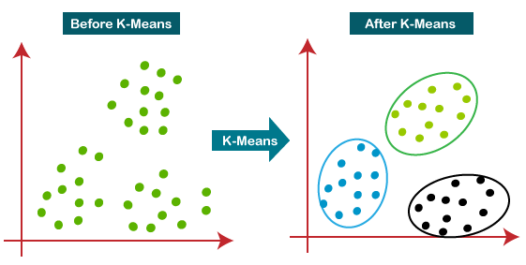
The k-means clustering algorithm mainly performs two tasks:
Determines the best value for K center points or centroids by an iterative process.
Assigns each data point to its closest k-center. Those data points which are near to the particular k-center, create a cluster.
Hence each cluster has datapoints with some commonalities, and it is away from other clusters.
The below diagram explains the working of the K-means Clustering Algorithm:

Slide 45
How does the K-Means Algorithm Work?
The working of the K-Means algorithm is explained in the below steps:
Step-1: Select the number K to decide the number of clusters.
Step-2: Select random K points or centroids. (It can be other from the input dataset).
Step-3: Assign each data point to their closest centroid, which will form the predefined K clusters
Step-4: Calculate the variance and place a new centroid of each cluster.
Step-5: Repeat the third steps, which means reassign each datapoint to the new closest centroid of each cluster.
Step-6: If any reassignment occurs, then go to step-4 else go to FINISH.
Step-7: The model is ready.

Slide 46
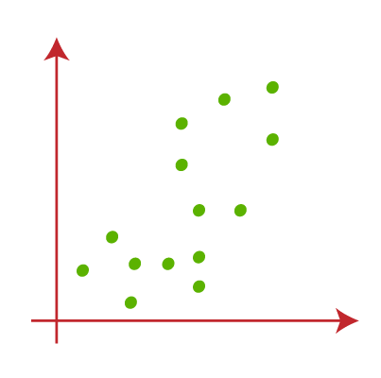
Suppose we have two variables M1 and M2. The x-y axis scatter plot of these two variables is given below:

Slide 47
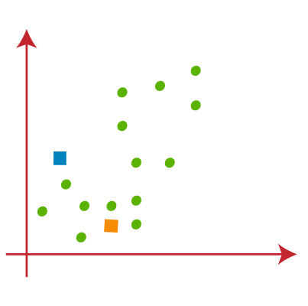
Let's take number k of clusters, i.e., K=2, to identify the dataset and to put them into different clusters. It means here we will try to group these datasets into two different clusters.
We need to choose some random k points or centroid to form the cluster. These points can be either the points from the dataset or any other point. So, here we are selecting the below two points as k points, which are not the part of our dataset.

Slide 48
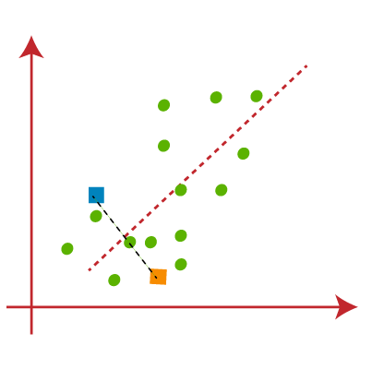
Now we will assign each data point of the scatter plot to its closest K-point or centroid. We will compute it by applying some mathematics that we have studied to calculate the distance between two points. So, we will draw a median between both the centroids.
Consider the below image:
From the image, it is clear that points left side of the line is near to the K1 or blue centroid, and points to the right of the line are close to the yellow centroid. Let's color them as blue and yellow for clear visualization.

Slide 49
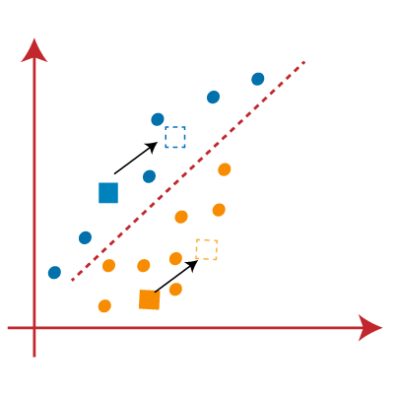
As we need to find the closest cluster, so we will repeat the process by choosing a new centroid.
To choose the new centroids, we will compute the center of gravity of these centroids, and will find new centroids as below:
Next, we will reassign each datapoint to the new centroid. For this, we will repeat the same process of finding a median line. The median will be like below image:

Slide 50
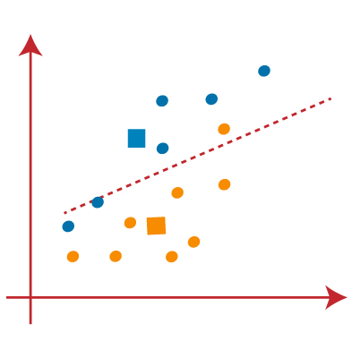
From the above image, we can see, one yellow point is on the left side of the line, and two blue points are right to the line. So, these three points will be assigned to new centroids.

Slide 51
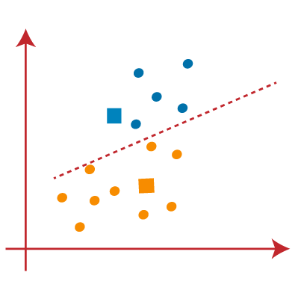
As reassignment has taken place, so we will again go to the step-4, which is finding new centroids or K-points.

Slide 52
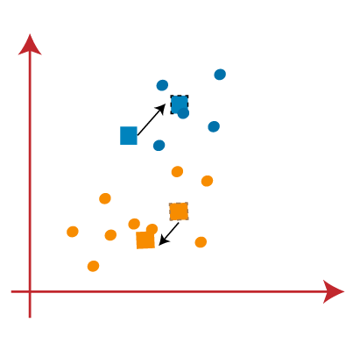
We will repeat the process by finding the center of gravity of centroids, so the new centroids will be as shown in the below image:

Slide 53
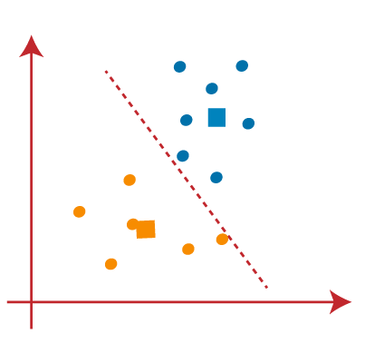
As we got the new centroids so again will draw the median line and reassign the data points.
So, the image will be:

Slide 54
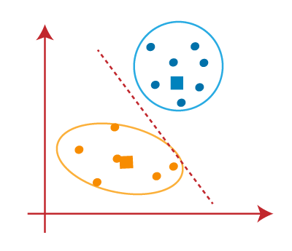
We can see in the above image; there are no dissimilar data points on either side of the line, which means our model is formed.
Consider the below image:

Slide 55
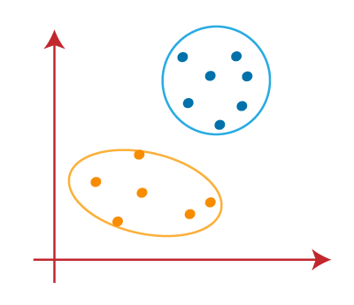
As our model is ready, so we can now remove the assumed centroids, and the two final clusters will be as shown in the below image:

Slide 56
How to choose the value of "K number of clusters" in K-means Clustering?
The performance of the K-means clustering algorithm depends upon highly efficient clusters that it forms. But choosing the optimal number of clusters is a big task. There are some different ways to find the optimal number of clusters, but here we are discussing the most appropriate method to find the number of clusters or value of K.
How to choose the value of "K number of clusters" in K-means Clustering?
The performance of the K-means clustering algorithm depends upon highly efficient clusters that it forms. But choosing the optimal number of clusters is a big task. There are some different ways to find the optimal number of clusters, but here we are discussing the most appropriate method to find the number of clusters or value of K.
WCSS= ∑_{Pi in Cluster1} distance(P_{i} C₁)² +∑_{Pi in Cluster2}distance(P_{i} C₂)²+∑_{Pi in CLuster3} distance(P_{i} C₃)²
In the above formula of WCSS,
∑_{Pi in Cluster1} distance(P_{i} C₁)²: It is the sum of the square of the distances between each data point and its centroid within a cluster1 and the same for the other two terms.
To measure the distance between data points and centroid, we can use any method such Euclidean distance or Manhattan.

Slide 57
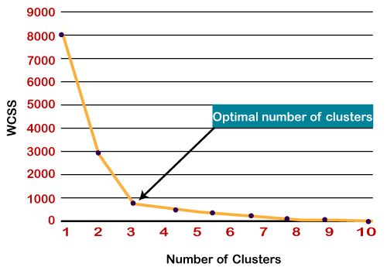
To find the optimal value of clusters, the elbow method follows the below steps:
It executes the K-means clustering on a given dataset for different K values (ranges from 1-10).
For each value of K, calculates the WCSS value.
Plots a curve between calculated WCSS values and the number of clusters K.
The sharp point of bend or a point of the plot looks like an arm, then that point is considered as the best value of K.
Since the graph shows the sharp bend, which looks like an elbow, hence it is known as the elbow method.
Note: We can choose the number of clusters equal to the given data points. If we choose the number of clusters equal to the data points, then the value of WCSS becomes zero, and that will be the endpoint of the plot.

Slide 58
Python Implementation of K-means Clustering Algorithm:
In the above section, we have discussed the K-means algorithm, now let's see how it can be implemented using Python.
Before implementation, let's understand what type of problem we will solve here. So, we have a dataset of Mall_Customers, which is the data of customers who visit the mall and spend there.
In the given dataset, we have Customer_Id, Gender, Age, Annual Income ($), and Spending Score (which is the calculated value of how much a customer has spent in the mall, the more the value, the more he has spent). From this dataset, we need to calculate some patterns, as it is an unsupervised method, so we don't know what to calculate exactly.
The steps to be followed for the implementation are given below:
Data Pre-processing
Finding the optimal number of clusters using the elbow method
Training the K-means algorithm on the training dataset
Visualizing the clusters

Slide 59
Step-1: Data pre-processing Step:
The first step will be the data pre-processing, as we did in our earlier topics of Regression and Classification.
But for the clustering problem, it will be different from other models.
Importing Libraries
# importing libraries
import numpy as nm
import matplotlib.pyplot as mtp
import pandas as pd

Slide 60
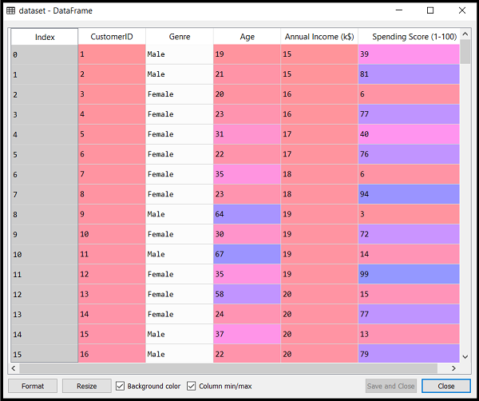
# Importing the dataset
dataset = pd.read_csv('Mall_Customers_data.csv’)
Extracting Independent Variables
Here we don't need any dependent variable for data pre-processing step as it is a clustering problem, and we have no idea about what to determine. So we will just add a line of code for the matrix of features.
x = dataset.iloc[:, [3, 4]].values
As we can see, we are extracting only 3rd and 4th feature. It is because we need a 2d plot to visualize the model, and some features are not required, such as customer_id.

Slide 61
Step-2: Finding the optimal number of clusters using the elbow method:
In the second step, we will try to find the optimal number of clusters for our clustering problem. So, as discussed above, here we are going to use the elbow method for this purpose.
As we know, the elbow method uses the WCSS concept to draw the plot by plotting WCSS values on the Y-axis and the number of clusters on the X-axis. So we are going to calculate the value for WCSS for different k values ranging from 1 to 10.
# finding optimal number of clusters using the elbow method
from sklearn.cluster import KMeans
wcss_list= [] #Initializing the list for the values of WCSS
# Using for loop for iterations from 1 to 10.
for i in range(1, 11):
kmeans = KMeans(n_clusters=i, init='k-means++', random_state= 42)
kmeans.fit(x)
wcss_list.append(kmeans.inertia_)
mtp.plot(range(1, 11), wcss_list)
mtp.title('The Elobw Method Graph')
mtp.xlabel('Number of clusters(k)')
mtp.ylabel('wcss_list')
mtp.show()

Slide 62
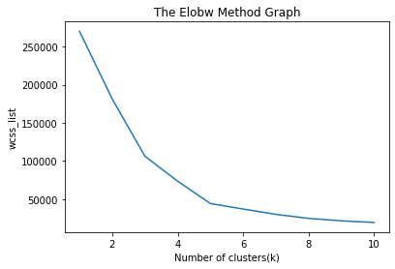
Output:
From the above plot, we can see the elbow point is at 5. So the number of clusters here will be 5.

Slide 63
Step- 3: Training the K-means algorithm on the training dataset
As we have got the number of clusters, so we can now train the model on the dataset.
To train the model, we will use the same two lines of code as we have used in the above section, but here instead of using i, we will use 5, as we know there are 5 clusters that need to be formed. The code is given below:
# Training the K-means model on a dataset
kmeans = KMeans(n_clusters=5, init='k-means++', random_state= 42)
y_predict= kmeans.fit_predict(x)

Slide 64
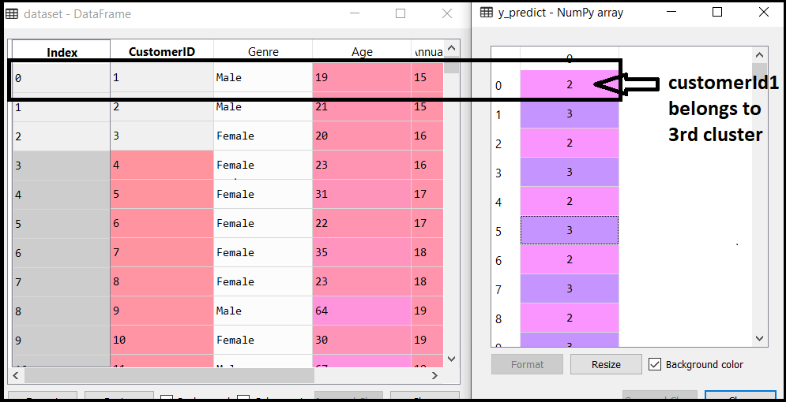
From the above image, we can now relate that the CustomerID 1 belongs to a cluster 3
(as index starts from 0, hence 2 will be considered as 3), and 2 belongs to cluster 4, and so on.

Slide 65
Step-4: Visualizing the Clusters:
The last step is to visualize the clusters.
As we have 5 clusters for our model, so we will visualize each cluster one by one.
#visualizing the clusters
mtp.scatter(x[y_predict == 0, 0], x[y_predict == 0, 1], s = 100, c = 'blue', label = 'Cluster 1') #for first cluster
mtp.scatter(x[y_predict == 1, 0], x[y_predict == 1, 1], s = 100, c = 'green', label = 'Cluster 2') #for second cluster
mtp.scatter(x[y_predict== 2, 0], x[y_predict == 2, 1], s = 100, c = 'red', label = 'Cluster 3') #for third cluster
mtp.scatter(x[y_predict == 3, 0], x[y_predict == 3, 1], s = 100, c = 'cyan', label = 'Cluster 4') #for fourth cluster
mtp.scatter(x[y_predict == 4, 0], x[y_predict == 4, 1], s = 100, c = 'magenta', label = 'Cluster 5') #for fifth cluster
mtp.scatter(kmeans.cluster_centers_[:, 0], kmeans.cluster_centers_[:, 1], s = 300, c = 'yellow', label = 'Centroid’)
mtp.title('Clusters of customers')
mtp.xlabel('Annual Income (k$)')
mtp.ylabel('Spending Score (1-100)’)
mtp.legend()
mtp.show()

Slide 66
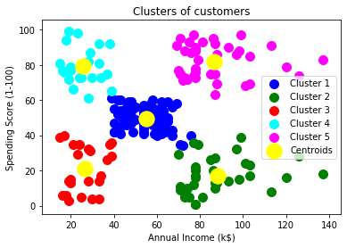
Output:
Cluster1 shows the customers with average salary and average spending so we can categorize these customers as
Cluster2 shows the customer has a high income but low spending, so we can categorize them as careful.
Cluster3 shows the low income and also low spending so they can be categorized as sensible.
Cluster4 shows the customers with low income with very high spending so they can be categorized as careless.
Cluster5 shows the customers with high income and high spending so they can be categorized as target, and these customers can be the most profitable customers for the mall owner.

Slide 67
Introduction to Dimensionality Reduction Technique

Slide 68
What is Dimensionality Reduction?
The number of input features, variables, or columns present in a given dataset is known as dimensionality, and the process to reduce these features is called dimensionality reduction.
A dataset contains a huge number of input features in various cases, which makes the predictive modeling task more complicated. Because it is very difficult to visualize or make predictions for the training dataset with a high number of features, for such cases, dimensionality reduction techniques are required to use.
Dimensionality reduction technique can be defined as, "It is a way of converting the higher dimensions dataset into lesser dimensions dataset ensuring that it provides similar information."
These techniques are widely used in machine learning for obtaining a better fit predictive model while solving the classification and regression problems.
It is commonly used in the fields that deal with high-dimensional data, such as speech recognition, signal processing, bioinformatics, etc. It can also be used for data visualization, noise reduction, cluster analysis, etc.

Slide 69
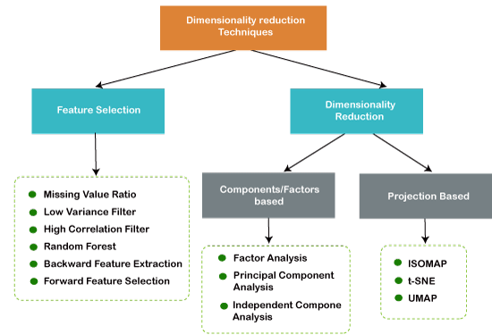

Slide 70
The Curse of Dimensionality:
Handling the high-dimensional data is very difficult in practice, commonly known as the curse of dimensionality. If the dimensionality of the input dataset increases, any machine learning algorithm and model becomes more complex. As the number of features increases, the number of samples also gets increased proportionally, and the chance of overfitting also increases. If the machine learning model is trained on high-dimensional data, it becomes overfitted and results in poor performance.
Benefits of applying Dimensionality Reduction:
Some benefits of applying dimensionality reduction technique to the given dataset are given below:
By reducing the dimensions of the features, the space required to store the dataset also gets reduced.
Less Computation training time is required for reduced dimensions of features.
Reduced dimensions of features of the dataset help in visualizing the data quickly.
It removes the redundant features (if present) by taking care of multicollinearity.

Slide 71
Disadvantages of dimensionality Reduction:
There are also some disadvantages of applying the dimensionality reduction, which are given below:
Some data may be lost due to dimensionality reduction.
In the PCA dimensionality reduction technique, sometimes the principal components required to consider are unknown.
Approaches of Dimension Reduction:
There are two ways to apply the dimension reduction technique, which are given below:
Feature Selection
Feature selection is the process of selecting the subset of the relevant features and leaving out the irrelevant features present in a dataset to build a model of high accuracy. In other words, it is a way of selecting the optimal features from the input dataset.
Three methods are used for the feature selection:
1. Filters Methods
In this method, the dataset is filtered, and a subset that contains only the relevant features is taken. Some common techniques of filters method are:
Correlation
Chi-Square Test
ANOVA
Information Gain, etc.

Slide 72
2. Wrappers Methods:
The wrapper method has the same goal as the filter method, but it takes a machine learning model for its evaluation. In this method, some features are fed to the ML model, and evaluate the performance. The performance decides whether to add those features or remove to increase the accuracy of the model. This method is more accurate than the filtering method but complex to work. Some common techniques of wrapper methods are:
Forward Selection
Backward Selection
Bi-directional Elimination
3. Embedded Methods:
Embedded methods check the different training iterations of the machine learning model and evaluate the importance of each feature. Some common techniques of Embedded methods are:
LASSO
Elastic Net
Ridge Regression, etc.

Slide 73
Common techniques of Dimensionality Reduction:
Principal Component Analysis
Backward Elimination
Forward Selection
Score comparison
Missing Value Ratio
Low Variance Filter
High Correlation Filter
Random Forest
Factor Analysis
Auto-Encoder
Principal Component Analysis (PCA):
Principal Component Analysis is a statistical process that converts the observations of correlated features into a set of linearly uncorrelated features with the help of orthogonal transformation. These new transformed features are called the Principal Components. It is one of the popular tools that is used for exploratory data analysis and predictive modeling.
PCA works by considering the variance of each attribute because the high attribute shows the good split between the classes, and hence it reduces the dimensionality. Some real-world applications of PCA are image processing, movie recommendation system, optimizing the power allocation in various communication channels.

Slide 74
Backward Feature Elimination :
The backward feature elimination technique is mainly used while developing Linear Regression or Logistic Regression model. Below steps are performed in this technique to reduce the dimensionality or in feature selection:
In this technique, firstly, all the n variables of the given dataset are taken to train the model.
The performance of the model is checked.
Now we will remove one feature each time and train the model on n-1 features for n times, and will compute the performance of the model.
We will check the variable that has made the smallest or no change in the performance of the model, and then we will drop that variable or features; after that, we will be left with n-1 features.
Repeat the complete process until no feature can be dropped.
In this technique, by selecting the optimum performance of the model and maximum tolerable error rate, we can define the optimal number of features require for the machine learning algorithms.

Slide 75
Forward Feature Selection :
Forward feature selection follows the inverse process of the backward elimination process. It means, in this technique, we don't eliminate the feature; instead, we will find the best features that can produce the highest increase in the performance of the model. Below steps are performed in this technique:
We start with a single feature only, and progressively we will add each feature at a time.
Here we will train the model on each feature separately.
The feature with the best performance is selected.
The process will be repeated until we get a significant increase in the performance of the model.
Missing Value Ratio :
If a dataset has too many missing values, then we drop those variables as they do not carry much useful information.
To perform this, we can set a threshold level, and if a variable has missing values more than that threshold, we will drop that variable. The higher the threshold value, the more efficient the reduction.

Slide 76
Low Variance Filter:
As same as missing value ratio technique, data columns with some changes in the data have less information.
Therefore, we need to calculate the variance of each variable, and all data columns with variance lower than a given threshold are dropped because low variance features will not affect the target variable.
High Correlation Filter :
High Correlation refers to the case when two variables carry approximately similar information.
Due to this factor, the performance of the model can be degraded.
This correlation between the independent numerical variable gives the calculated value of the correlation coefficient. If this value is higher than the threshold value, we can remove one of the variables from the dataset.
We can consider those variables or features that show a high correlation with the target variable.

Slide 77
Random Forest:
Random Forest is a popular and very useful feature selection algorithm in machine learning. This algorithm contains an in-built feature importance package, so we do not need to program it separately. In this technique, we need to generate a large set of trees against the target variable, and with the help of usage statistics of each attribute, we need to find the subset of features.
Random forest algorithm takes only numerical variables, so we need to convert the input data into numeric data using hot encoding.
Factor Analysis:
Factor analysis is a technique in which each variable is kept within a group according to the correlation with other variables, it means variables within a group can have a high correlation between themselves, but they have a low correlation with variables of other groups.
We can understand it by an example, such as if we have two variables Income and spend. These two variables have a high correlation, which means people with high income spends more, and vice versa. So, such variables are put into a group, and that group is known as the factor. The number of these factors will be reduced as compared to the original dimension of the dataset.

Slide 78
Auto-encoders :
One of the popular methods of dimensionality reduction is auto-encoder, which is a type of ANN or artificial neural network, and its main aim is to copy the inputs to their outputs. In this, the input is compressed into latent-space representation, and output is occurred using this representation. It has mainly two parts:
Encoder: The function of the encoder is to compress the input to form the latent-space representation.
Decoder: The function of the decoder is to recreate the output from the latent-space representation.

Slide 79
THE END

